Slide 1

DEPARTMENT OF ELECTRICAL AND ELECTRONICS ENGINEERING
18EEP109L – MAJOR PROJECT FIRST REVIEW
Digital Watermarking Of Audio Signals For Enhanced Signal Protection
Project by:-
Shruti Srivastava (RA1811005010271)
Gautam Nag (RA1811005010278)
Project guide :-
Dr. C. NAVEEN
Assistant Professor , Dept. of EEE

Slide 2
LITERATURE SURVEY
SR. NO. | TITLE OF PAPER | AUTHOR | REMARKS
1 | An Effective Watermarking Method Based on Energy Averaging in Audio Signals | S. E. Tsai and S. M. Yang | The paper proposes a spread time echo method by using pseudonoise sequencing for digital watermarking.
2 | Digital Watermarks for Audio Signals | Laurence Boney, Ahmed H. Tewk and Khaled N. Hamdy | The paper elaborates the term “pirate” and how PN sequencing can easily decrypt normal encryption and therefore why it is important to do digital - watermarking.
3 | Efficient watermarking algorithm for digital audio/speech signal | M. Yamini, H.Karmouni, M.Sayyouri | A blind and audio/speech watermarking algorithm that combines the discrete Tchebichef moment transform (DTMT), the chaotic system of the mixed linear–nonlinear coupled map lattices (MLNCML), and discrete wavelet transform (DWT). In addition, the adopted strategy has a blind nature, where no original audio/speech is needed in watermark extraction.

Slide 3
LITERATURE SURVEY
SR. NO. | TITLE OF PAPER | AUTHOR | REMARKS
4 | Digital audio watermarking for QoS assessment of MP3 music signals | F.Benedetto,G.Guinta, A.Neri | This paper proposes an audio watermarking signal processing technique to provide a quality assessment of the received audio signal after coding/transmission process.
5 | A blind quantum audio watermarking based on quantum discrete cosine transform | Mohsen Yousefi Nejad, Mohammad Mosleh | This study presents a blind quantum audio watermarking scheme based on quantum discrete cosine transform (qDCT). The quantum audio signal in quantum representation of discrete signal (QRDS) is transformed into frequency domain using qDCT. The medium frequency components are selected as the target of watermarking.
6 | Development of an audio watermarking with decentralization of the watermarks | Amita Singha, Muhammad Ahsan Ullah | The proposed technique is executed by incorporating multi-level DWT along with the use of multiple images with different sizes as watermarks.

Slide 4
Problem Formulation
In today's world we know the importance of encryption and privacy and with data being the most prized possession it is more important than ever to protect that data. Therefore for our project we are aiming at using this as our principal objective for protecting signal and audio during transmission.
To do this will use digital watermarking and using a digital image/unique code superimposing the signal and then transposing that image as a watermark on the audio signal.
We believe that doing so will uniquely enhance the audio signal many times.

Slide 5
Objective
As we all know in this digital era data is the most valuable possession that one has. Hence in order to ensure the security and confidentiality of the content present in audio signals, we propose the idea of protecting an audio signal or audio file by encrypting it with a digital watermark.
This will ensure that each audio signal transmission and reception is protected from both ends of the communication.

Slide 6
Methodology
We started with the classification of the audio signal and dividing it by parameters such as their bandwidth, nominal level, power level in decibels (dB), and voltage level. The relationship between power and voltage is determined by the impedance of the signal path. Signal paths may be single-ended or balanced.
After analysis some research papers we found that audio signals have somewhat standardized levels depending on the application. Outputs of professional mixing consoles are most commonly at line level. Consumer audio equipment will also output at a lower line level. Microphones generally output at an even lower level, commonly referred to as mic level. For our project we will focus on the line level.
For our work we will be using MATLAB and Audacity which is an open source - multi platform software. This is an inhouse project for which the minimum specifications required to run the project are as follows:
OS - Windows 7 and Above
Processing power - 1.8GHz minimum
RAM - 2GB and above

Slide 7
Work Completion
We are done with the literature review part of the paper and have tested the Waveform Audio File Format in the preliminary stages. We used a file that contained audio recordings with different sampling rates and bit rates but are were saved in a 44.1 kHz, 16-bit format on Audacity.
These files were divided into host and port WAV’s and sampled onto Audacity and was mapped using the microsoft sound mapper at the following specifications:
Mono audio
44100 Hz
32 bit (floating point)
Mapping points (- 1.0 to 1.0)
Duration = 10 seconds
During this we found that any the traditional form of watermarking on an audio file can be easily decrypted at ‘line level’ using a software. To prove this we added a water mark at one junction and decrypted the signal using the “same software” and varying the parameters mentioned above. And found that the watermark (called as sis - gen) could easily be retrieved.
Then we varied it with 4 other forms of waves (sine, square, sawtooth, triangle) and took the readings (comparison is yet to be done) with gain set at +5 dB and frequency at 440 Hz:
Findings attached:

Slide 8
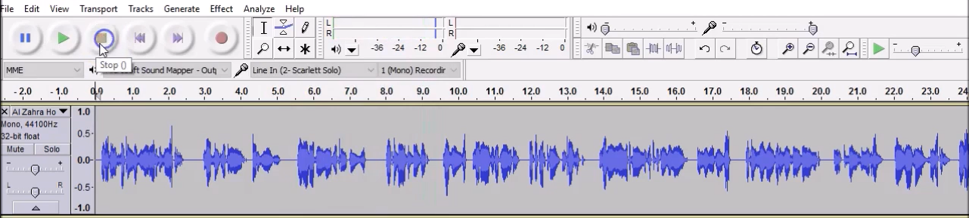
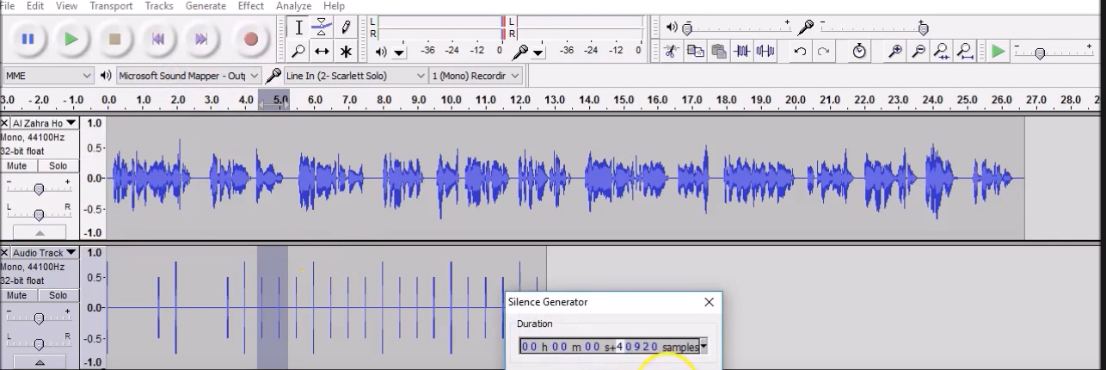

Slide 9
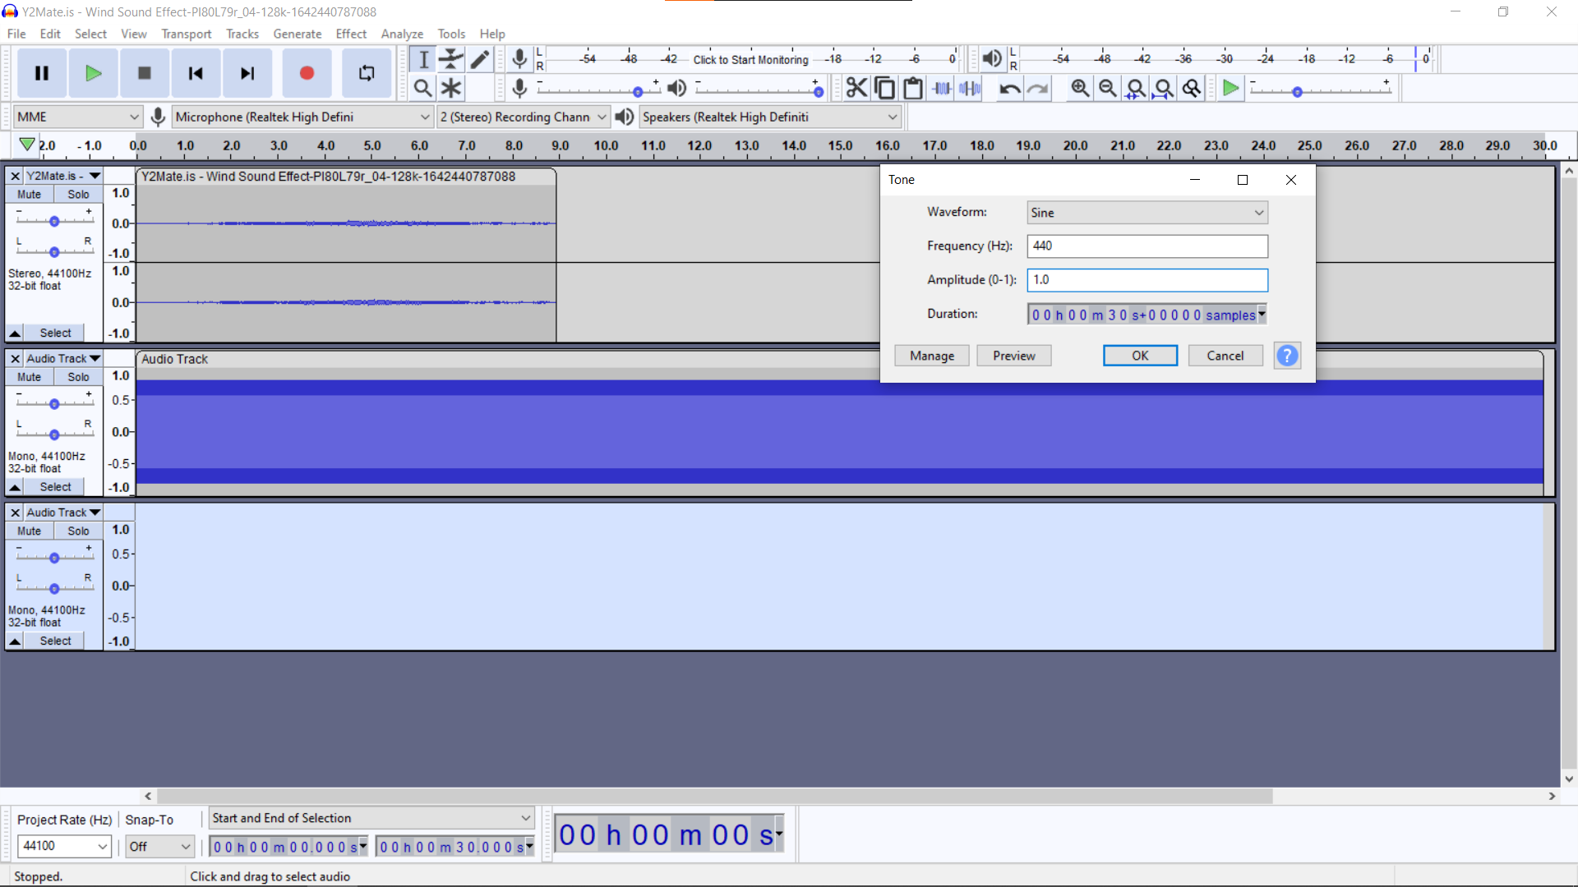
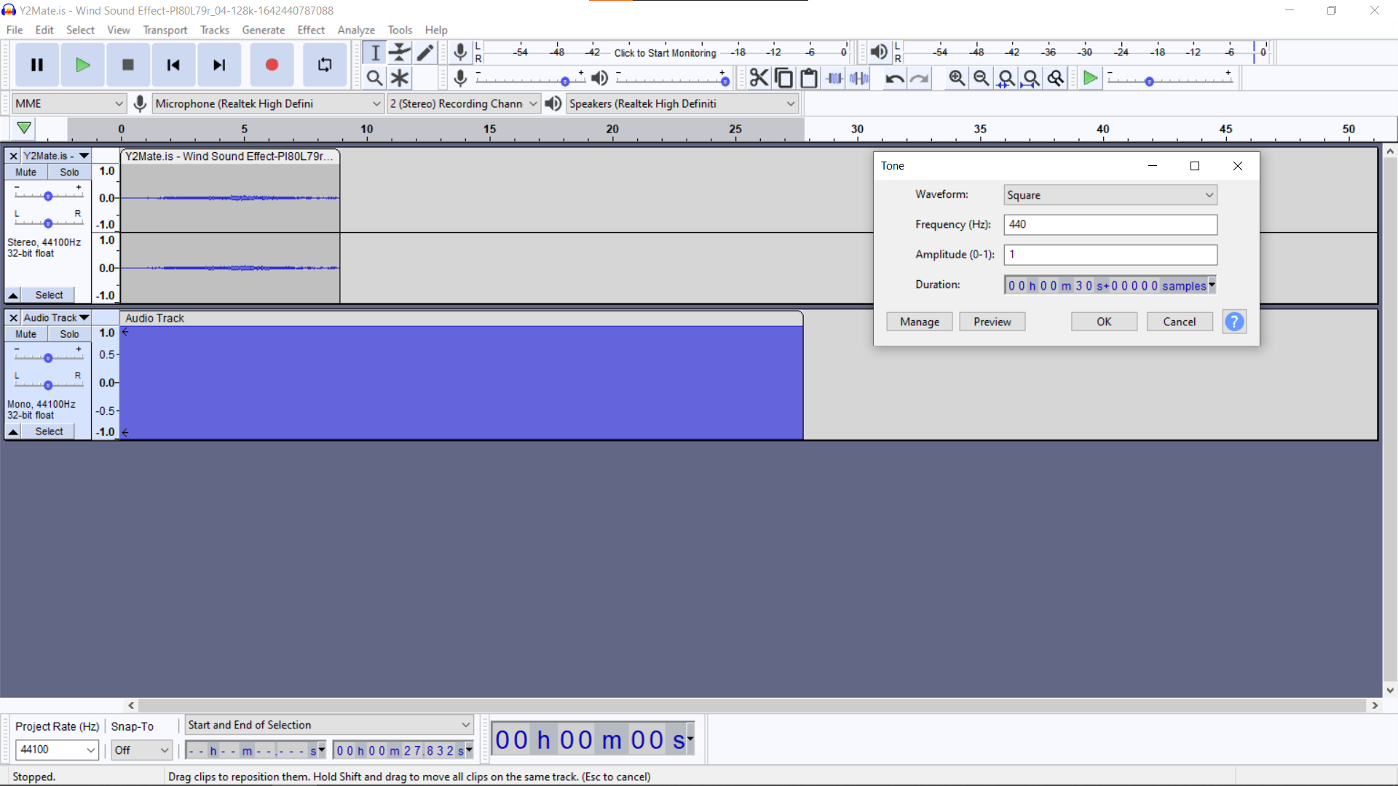
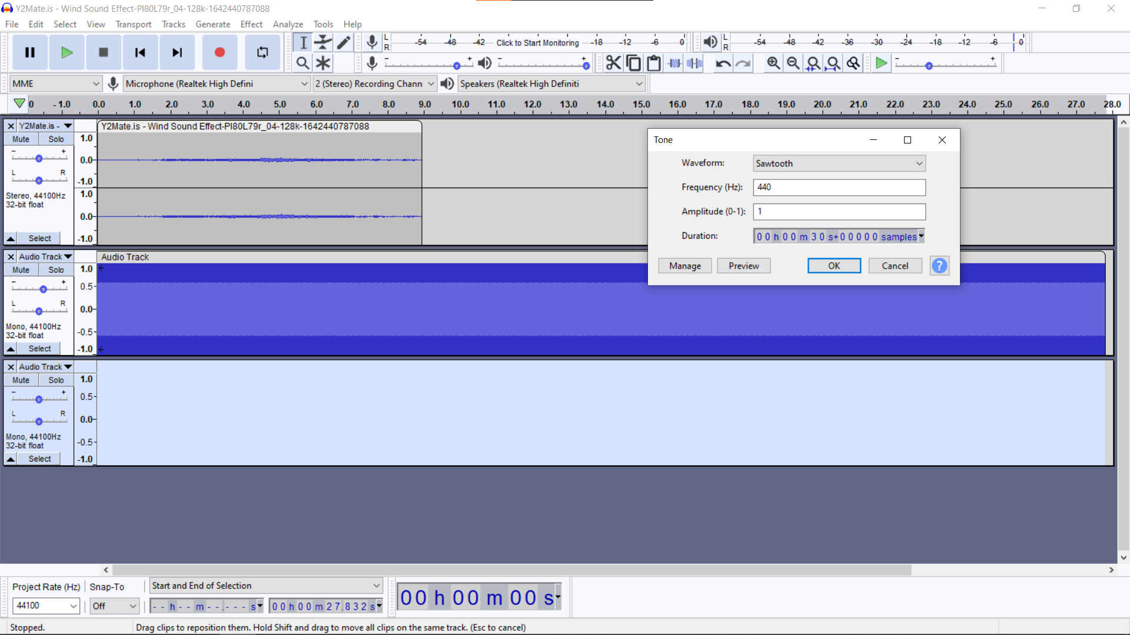
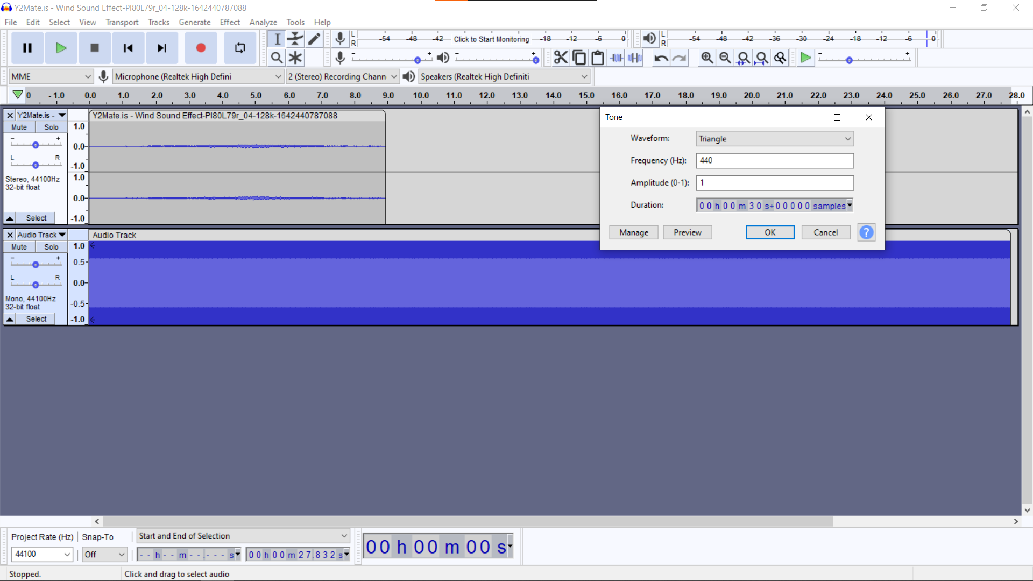
Sine
Square
Sawtooth
Triangle

Slide 10
WORK PLAN
S .No | Nature Of Work | Schedule | Status
1 | Literature Survey and Identification of basic Facilities to execute the project. | JANUARY 2022 | Completed
2 | Audio Classification (Audacity Simulation) | FEBRUARY 2022 | In Progress
3 | Mathematical Modeling (Algorithmic) |  | Yet To Be Done
4 | Mathematical Modeling (Variance) | MARCH 2022 | Yet To Be Done
5 | Digital Watermarking (MATLAB Coding) |  | Yet To Be Done
6 | Testing/Validation Phase | APRIL 2022 | Yet To Be Done
7 | Result Enhancement and Fine Tuning |  | Yet To Be Done

Slide 11
References
S. E. Tsai and S. M. Yang, An Effective Watermarking Method Based on Energy Averaging in Audio Signals: Hindawi Mathematical Problems in Engineering Volume 2018.
Laurence Boney, Ahmed H. Tewk and Khaled N. Hamdy, Digital Watermarks for Audio Signals, Département Signal, Department of Electrical Engineering, University of Minnesota: Minneapolis, MN 55455.
M. Yamini, H.Karmouni, M.Sayyouri, Efficient watermarking algorithm for digital audio/speech signal, Engineering, Systems and Applications Laboratory, National School of Applied Sciences, Sidi Mohamed Ben Abdellah University, BP 72, My Abdallah Avenue Km. 5 Imouzzer Road, Fez, Morocco.
F.Benedetto,G.Guinta, A.Neri, Digital audio watermarking for QoS assessment of MP3 music signals, Dept. of Applied Electronics, University of ROMA TRE, Rome, Italy.
Mohsen Yousefi Nejad, Mohammad Mosleh,A blind quantum audio watermarking based on quantum discrete cosine transform, Department of Computer Engineering, Tabriz Branch, Islamic Azad University, Tabriz, Iran.
Amita Singha, Muhammad Ahsan Ullah, Development of an audio watermarking with decentralization of the
Watermarks, Department of Computer Engineering, Tabriz Branch, Islamic Azad University, Tabriz, Iran

